Slide 1
Ensemble Learning

Slide 3
Ensemble Approaches
Bagging
Bootstrap aggregating
Boosting
Random Forests
Bagging reborn

Slide 4
Bagging
Main Assumption:
Combining many unstable predictors to produce a ensemble (stable) predictor.
Unstable Predictor: small changes in training data produce large changes in the model.
e.g. Neural Nets, trees
Stable: SVM (sometimes), Nearest Neighbor.
Hypothesis Space
Variable size (nonparametric):
Can model any function if you use an appropriate predictor (e.g. trees)

Slide 5
The Bagging Algorithm
Given data:
For
Obtain bootstrap sample from the training data
Build a model from bootstrap data

Slide 6
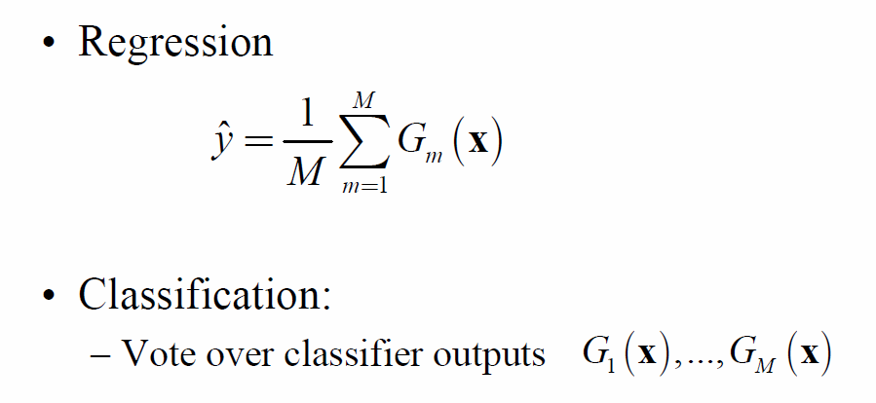
The Bagging Model
Regression
Classification:
Vote over classifier outputs

Slide 7
Bagging Details
Bootstrap sample of N instances is obtained by drawing N examples at random, with replacement.
On average each bootstrap sample has 63% of instances
Encourages predictors to have uncorrelated errors
This is why it works

Slide 8
Boosting
Main Assumption:
Combining many weak predictors (e.g. tree stumps or 1-R predictors) to produce an ensemble predictor
The weak predictors or classifiers need to be stable
Hypothesis Space
Variable size (nonparametric):
Can model any function if you use an appropriate predictor (e.g. trees)

Slide 9
Stacking, also known as stacked generalization or model stacking, is an ensemble machine learning technique that combines multiple base models (classifiers or regressors) to improve predictive performance.
It aims to leverage the strengths of different models by training a meta-model that learns how to best combine the predictions of these base models.

Slide 10
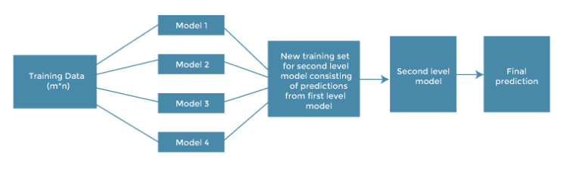

Slide 11
Original data: This data is divided into n-folds and is also considered test data or training data.
Base models: These models are also referred to as level-0 models. These models use training data and provide compiled predictions (level-0) as an output.
Level-0 Predictions: Each base model is triggered on some training data and provides different predictions, which are known as level-0 predictions.

Slide 12
Meta Model: The architecture of the stacking model consists of one meta-model, which helps to best combine the predictions of the base models. The meta-model is also known as the level-1 model.
Level-1 Prediction: The meta-model learns how to best combine the predictions of the base models and is trained on different predictions made by individual base models, i.e., data not used to train the base models are fed to the meta-model, predictions are made, and these predictions, along with the expected outputs, provide the input and output pairs of the training dataset used to fit the meta-model.

Slide 13
How stacking works?
We split the training data into K-folds just like K-fold cross-validation.
A base model is fitted on the K-1 parts and predictions are made for Kth part.
We do for each part of the training data.
The base model is then fitted on the whole train data set to calculate its performance on the test set.
We repeat the last 3 steps for other base models.
Predictions from the train set are used as features for the second level model.
Second level model is used to make a prediction on the test set.

